Slide 1

Programming languages
Power of coding

Slide 2
Why do we need programming languages??
Language is medium for communication. If two parties like to communicate or exchange the thoughts they must know a language. Language should be understandable by both the Parties. For example A wants to talk to B. A only knows English. B only knows Spanish. A and B can’t communicate till both A and B know a common language.
Computer is a machine and we are human beings. Human wants to talk to Computer. Both must know a common language. These languages which are understandable by both Human and Computer are called Programming languages. C, C++, JAVA, FORTRAN, COBOL, Python etc. are the Programming languages.
A person interacts with Computer using instructions. A set of instruction is called program. The art of writing or developing a program is called programming. So programming language is medium using which we can communicate with the Computer.

Slide 3
Why do we need programming languages??
Programming Language is important in our daily life to enhance and increase the power of computers, mobile solutions, and the internet. There are numerous examples you may come to know when you are going to learn a programming language. The actual power of the language is when the right programmer uses it with the right features to solve a problem or for any other specific purpose. Learning a programming language is exciting!

Slide 4
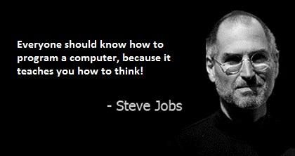
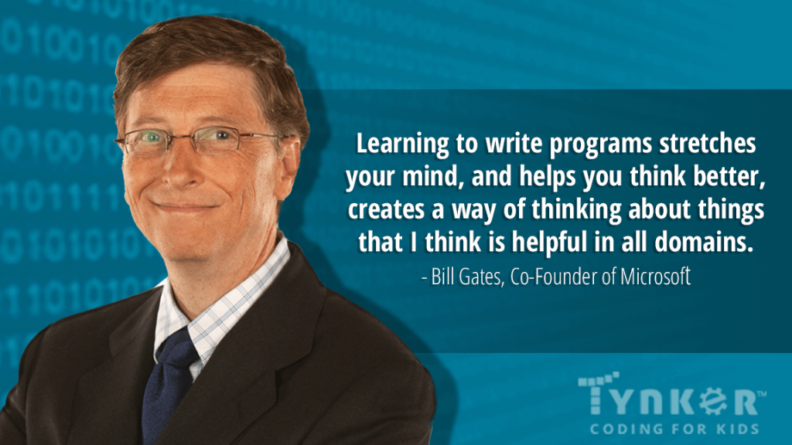
Motivational Coding Quotes from Greatest Entrepreneurs in the World
Steve Jobs, in full Steven Paul Jobs, (born February 24, 1955, San Francisco, California, U.S.—died October 5, 2011, Palo Alto, California), cofounder of Apple Computer, Inc. (now Apple Inc.), and a charismatic pioneer of the personal computer era.
Bill Gates, in full William Henry Gates III, (born October 28, 1955, Seattle, Washington, U.S.), American computer programmer and entrepreneur who cofounded Microsoft Corporation, the world’s largest personal-computer software company.

Slide 5
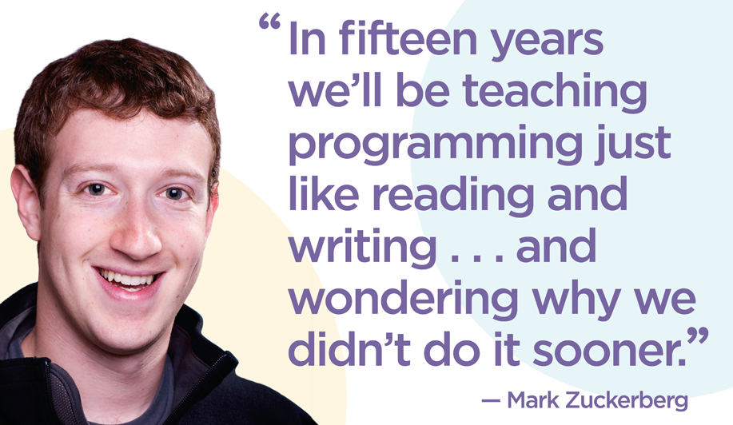
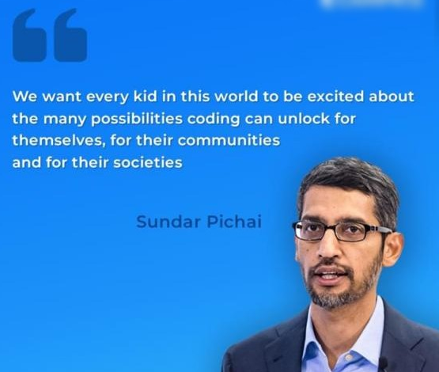
Motivational Coding Quotes from Greatest Entrepreneurs in the World
Mark Zuckerberg, in full Mark Elliot Zuckerberg, (born May 14, 1984, White Plains, New York, U.S.), American computer programmer who was cofounder and CEO(2004– ) of Facebook, a social networking Web site.
Sundar Pichai, in full Pichai Sundararajan, (born July 12, 1972, Madras [now Chennai], Tamil Nadu, India), Indian-born American executive who was CEO of both Google, Inc.(2015–), and its holding company, Alphabet Inc.(2019– ).

Slide 6
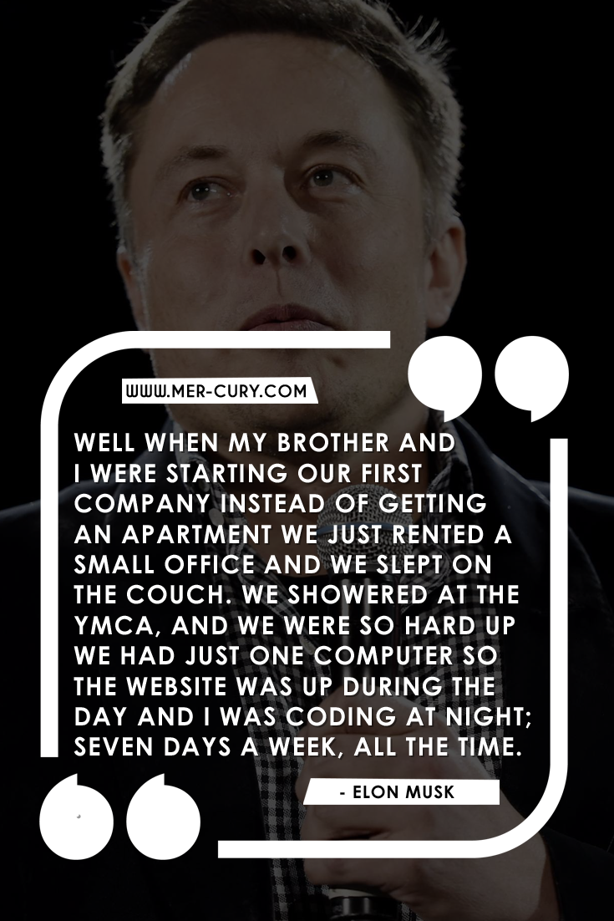
Motivational Coding Quotes from Greatest Entrepreneurs in the World
Elon Musk, (born June 28, 1971, Pretoria, South Africa), South African-born American entrepreneur who cofounded the electronic-payment firm PayPal and formed SpaceX, maker of launch vehicles and spacecraft. He was also one of the first significant investors in, as well as chief executive officer of, the electric car manufacturer Tesla.
The billionaire entrepreneur has achieved so many career milestones in his 44 years of life that it's hard to believe they've all happened to the same person. In advance of Tesla's grand reveal of the Model 3--the electric car Musk hopes will change the auto industry forever--here are seven of the biggest moments of his career so far.

Slide 7
List of DIFFERENT PROGRAMMING LANGUAGES
We have many programming languages, here we have list of 20.
1.C
2.C++
3.Java
4.Visual basic .NET
5.C#
6.Php
7.Javascript
8.Sql
9.Python
10.Objective – C
11.Delphi/object pascal
12.Ruby
13.Matlab
14.Assembly language
15.Swift
16.Go
17.Perl
18.R
19.PL/SQL
20.COBOL

